Slide 1


Customer Credit Analysis: Clustering and Prediction with Machine Learning
Prateek Bablani (2312791)
MBA, University Canada West
BUSI 651: Machine Learning Tools and Techniques
Professor: Sarah Gholibeigan
December 14th, 2024
This Photo by Unknown Author is licensed under CC BY-SA-NC

Slide 2

Executive Summary
Analyze customer credit behavior using machine learning.
Cluster customers and predict credit utilization.
Tools: K-Means, SHAP(Shapley Additive Explanations), LIME (Local Interpretable Model-Agnostic Explanations) Random Forest Classifier, Neural Network, KNN.
Outcome: Better risk management and customer targeting.

Slide 3

Dataset Overview
Source: CreditPrediction.csv.
Features:
Numerical: Age, Credit Limit, Transaction Counts.
Categorical: Gender, Education Level, Marital Status.
Size: 10,000 rows, 19 columns.

Slide 4

Problem Definition
Goal: To analyze customer credit behavior using both demographic data (age, gender, income, etc.) and financial activities, clustering them into distinct groups and predicting credit utilization.
Primary Objectives:
Use unsupervised clustering techniques to segment customers on demographic attributes and on credit-based features: utilization ratio, transaction frequency, and income level.
Predict credit utilization to identify fiscally high-risk customers.
Significance:
Enable focused strategies on high-value and high-risk customer segments.
Enhancing credit risk management and improving resource allocation.
Challenges:
Handling diversified data types-demographic and numerical data.
Ensuring accuracy and clarity in the models.

Slide 5

Data Preprocessing
Clustering Preprocessing: Missing values filled with median (Numerical ) and mode (Categorical )
Predictive Model Preprocessing: Missing values filled with median (Numerical ) and mode (Categorical )
Notes:
Data preprocessing ensures the dataset is consistent and model-ready.
Two models:
Clustering and Predcitive

Slide 6

Clustering Preprocessing
Categorical features included Gender, Education Level, Marital Status, and Income Category.
Numerical features normalized using MinMaxScaler.
Added a binary column Is_Fully_Inactive to highlight inactivity.
Notes:
"For clustering, we handled missing values and normalized numerical features using MinMaxScaler, adding a binary column for inactivity.

Slide 7
Predictive Model Preprocessing
New features created:
Debt-to-Credit Ratio
Monthly Transaction Amount
Utilization Change Rate
Numerical features standardized using StandardScale
Notes:
In contrast, the predictive model preprocessing introduced derived features like Debt-to-Credit Ratio and utilized StandardScaler to standardize numerical data. These steps lay the foundation for meaningful analysis and modelling."

Slide 8
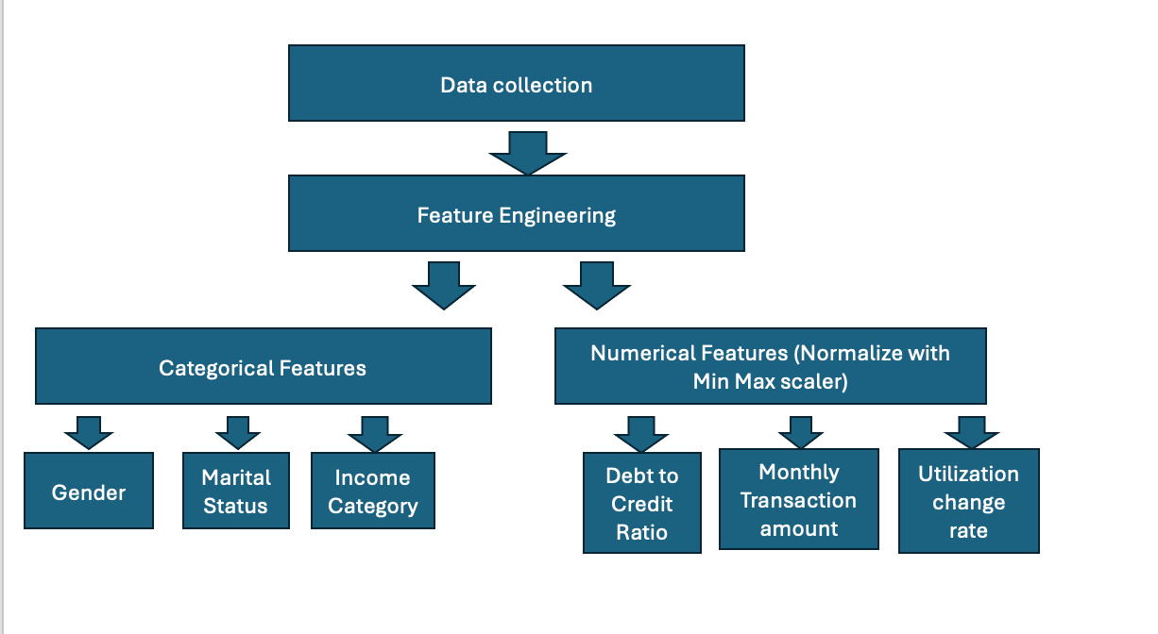
Raw data transformation into feature for clustering and prediction

Slide 9
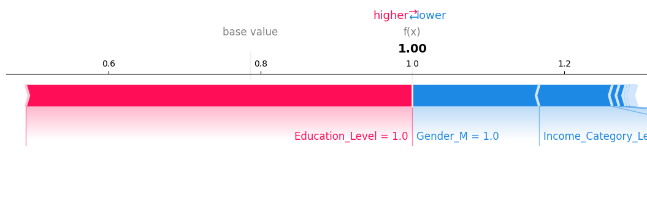
Feature Engineering
Clustering:
Encode categorical features: One-Hot Encoding for Gender, Education Level, etc.
Leverage existing features: Inactivity, transaction counts.
Prediction:
Create new features: Debt-to-Credit Ratio and u tilization Change Rate.
Target variable: Avg_Utilization_Ratio.
Notes:
Bar chart showing feature importance from SHAP analysis.
Feature engineering is essential to improve model performance. For clustering, we encoded categorical features using One-Hot Encoding and focused on existing features like inactivity and transaction counts. For the predictive model, we created new features, such as Debt-to-Credit Ratio, that directly influence credit behavior. These features help models uncover actionable insights about customer demographics and credit utilization patterns.

Slide 10
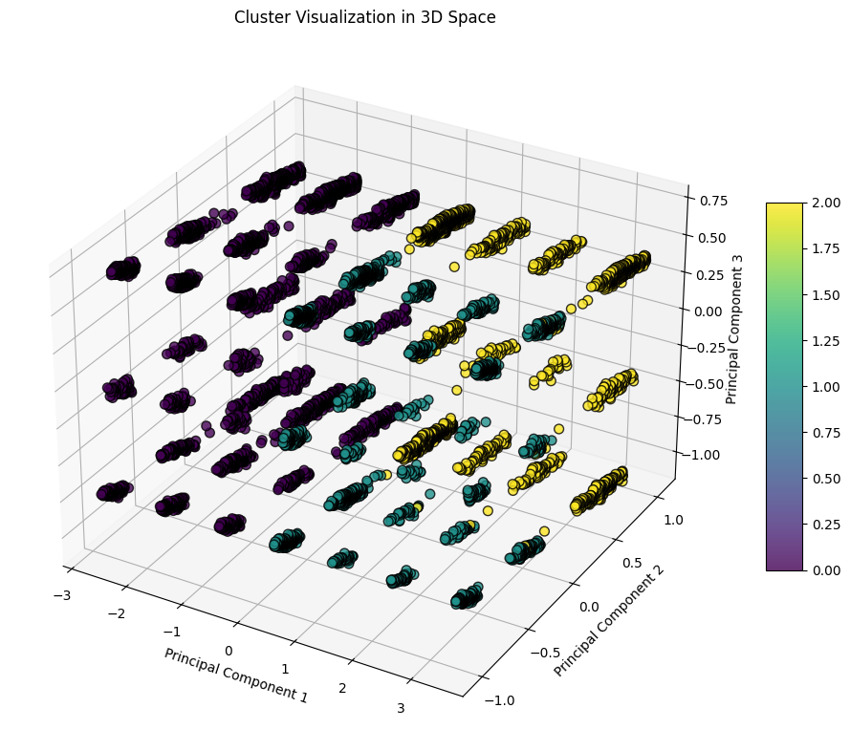
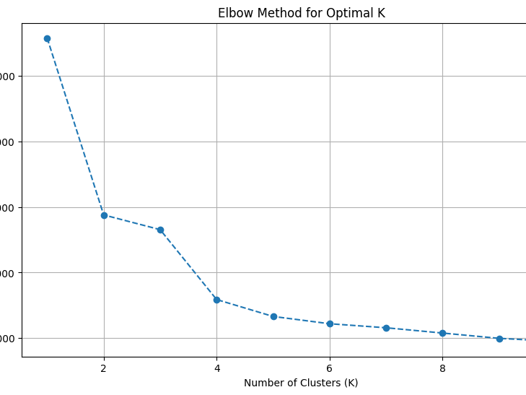
Clustering Model: Overview
Clustering Model: Overview
Goal: Segment customers based on behavioral and demographic features.
Techniques and Tools Used:
K-Means Clustering: Identified optimal clusters using the Elbow Method (K=3).
Dimensionality Reduction: Applied PCA (Principal Component Analysis) for visualization in 2D and 3D.
Explainability: SHAP and LIME were used to interpret feature contributions to cluster assignments.
Evaluation Metrics:
WCSS (Within-Cluster Sum of Squares): Measured compactness within clusters to ensure well-defined groupings.
Notes:
On this slide, we introduce the clustering model used for segmenting customers into distinct groups based on their behaviors and demographics.
We utilized K-Means clustering, determining the optimal number of clusters (K=3) using the Elbow Method. For better visualization and interpretability, we applied PCA to project the data into 2D and 3D spaces.
To ensure transparency, we integrated explainability techniques like SHAP and LIME, which helped us understand the key features driving the clustering process. For example, Education Level and Gender were among the top contributors.
Finally, we evaluated the model's performance using Within-Cluster Sum of Squares (WCSS), which measures compactness within clusters to validate the groupings. This approach ensures well-defined and actionable segments.

Slide 11

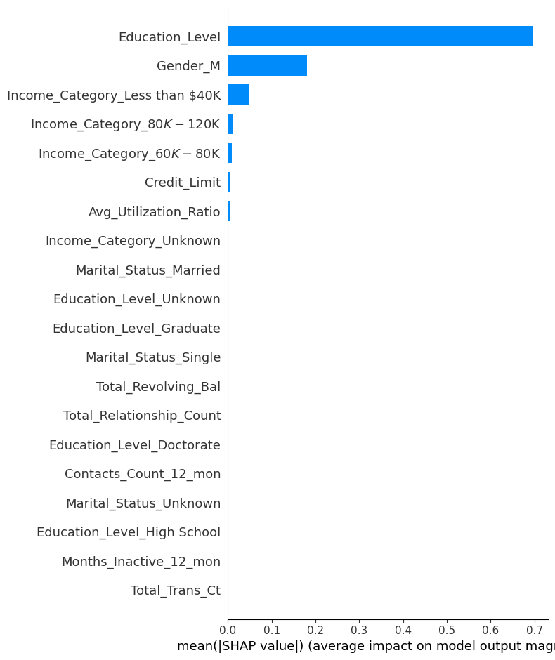
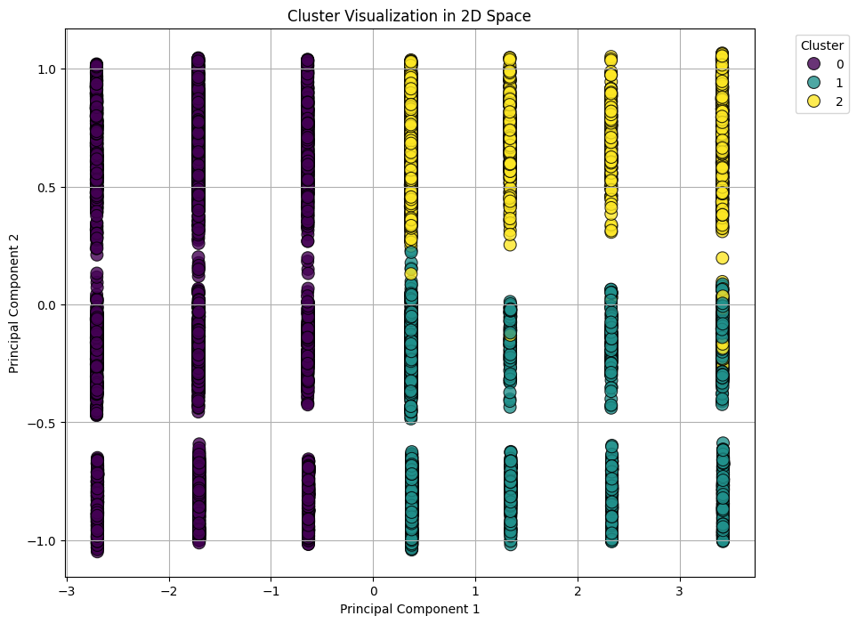
Clustering and Results
Cluster Characteristics:
Cluster 0: Moderate utilization, balanced transactions.
Cluster 1: Budget-conscious, low credit usage.
Cluster 2: High-value customers, premium behavior.
Visualization:
2D PCA plot for cluster separation.
3D PCA plot for dimensional insights.
Techniques Used:
SHAP (Shapley Additive Explanations): Summary Plot: Highlights feature importance (e.g., Education Level, Gender).
LIME (Local Interpretable Model-Agnostic Explanations): Provides local interpretability for individual cluster assignments.
Insights:
Cluster 0: Opportunities for mid-tier product promotion.
Cluster 1: Need for cost-effective retention strategies.
Cluster 2: Ideal for premium services and products.
Notes:
Introduction: "In this slide, we discuss the results of the clustering model, highlighting how customers were segmented into three distinct clusters based on their behavioral and demographic features."
Cluster Characteristics:
"Cluster 0 represents moderate utilization with balanced transaction activity, making them suitable for mid-tier product promotions."
"Cluster 1 is composed of budget-conscious customers with low credit usage, requiring cost-effective retention strategies."
"Cluster 2 includes high-value customers with premium behaviors, ideal for exclusive services and financial products."
Techniques Used:
"To ensure the reliability of our clustering results, we used SHAP for global feature importance, identifying Education Level and Gender as key drivers."
"LIME allowed us to explain individual cluster assignments, providing local interpretability for actionable insights.
Visualization:
"Here, we have a 2D PCA plot for visualizing cluster separations, along with a 3D PCA plot for dimensional insights."
Closing: "By analyzing these clusters, we can derive targeted strategies to engage customers more effectively and allocate resources optimally."

Slide 12

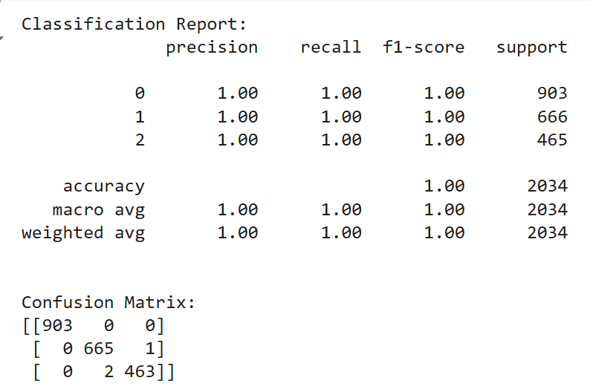
Predictive Model: Random Forest Classifier
Overview:
Goal: Classify customers into pre-defined clusters based on demographic and behavioral data.
Approach:
Random Forest Classifier with 100 estimators to ensure robustness.
Evaluated using:
Precision, Recall, and F1-Score to measure accuracy for each cluster.
Cross-Validation Accuracy for overall model reliability.
Techniques Used:
SHAP and LIME:
SHAP(Shapley Additive Explanations): Provides global feature importance, showcasing influential predictors like Education Level and Gender.
LIME (Local Interpretable Model-Agnostic Explanations): Offers local interpretability for individual predictions, adding actionable insights.
Proxy Decision Tree Model:
Used to simplify local feature explanations with a more interpretable representation
Insights: Combining demographic features with numerical data helps create actionable strategies:
Cluster 2 (High-Value Customers): Focus on offering premium financial products, such as exclusive credit cards or investment options.
Cluster 0 (Moderate Customers): Encourage responsible credit usage through educational initiatives.
Cluster 1 (Budget-Conscious): Provide cost-effective financial products to meet their needs.
Notes:
Key Models and Techniques:
Random Forest Classifier:
This model predicts cluster labels based on demographic and behavioral features.
Precision, Recall, and F1-Scores: These metrics, along with a perfect accuracy score of 1.00, demonstrate that the model effectively identifies customers in each cluster without misclassification.
SHAP (SHapley Additive Explanations):
Provides global feature importance, identifying critical features like Education Level and Gender as significant contributors to cluster predictions.
Links demographic data (e.g., Education Level, Gender) with numerical features (e.g., Credit Limit, Debt-to-Credit Ratio) to uncover how these factors collectively influence cluster assignments.
LIME (Local Interpretable Model-Agnostic Explanations):
Focuses on individual predictions, helping interpret how features uniquely impact a specific customer’s cluster.
Confusion Matrix:
Perfect classification with no misclassification, aligning predicted and actual cluster assignments.

Slide 13
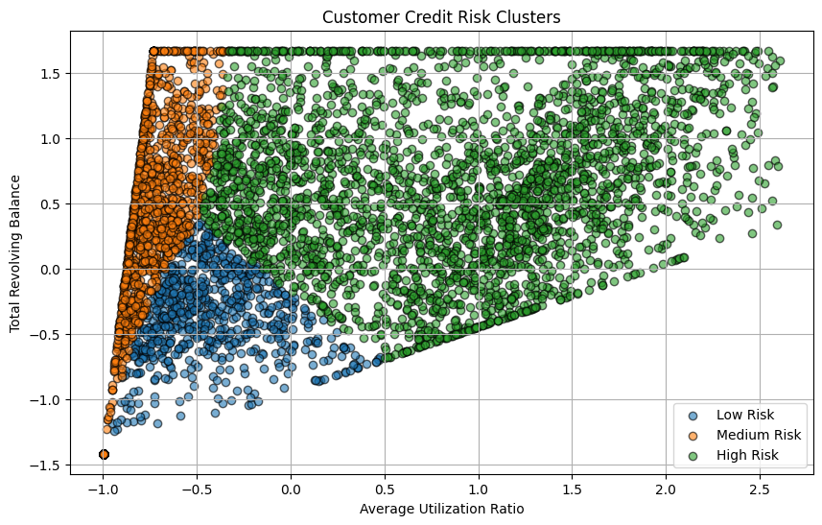
Predictive Model: KNN Regression
Slide 9b: Predictive Model: KNN Regression
Purpose:
Predict the average utilization ratio of customers.
Model Development:
Algorithm: K-Nearest Neighbors Regression.
Hyperparameter Tuning: Optimized n_neighbors using GridSearchCV.
Features Used: Debt-to-Credit Ratio, Utilization_Change_Rate, Monthly_Transaction_Amount.
Evaluation Metrics:
Mean Absolute Error (MAE): 0.18.
R-Squared (R²): 0.76.
GridSearchCV determined the best parameter for n_neighbors.
Insights:
Predicts how much of their credit customers are likely to use, assisting in risk assessment and targeted offerings.
Actionable Insights from KNN Regression:
Customers with higher Debt-to-Credit Ratios should be flagged for additional monitoring.
Predictive insights can help adjust credit limits or promotional strategies to ensure risk is minimized while customer needs are met.
Notes:
Visualization:
Graph of actual vs. predicted values.
Decision boundary plot to show how the model predicts credit utilization.
Script: "The KNN Regression model estimates customers' average credit utilization with precision, helping assess credit risk and fine-tune financial product strategies. Predictive insights show that customers with high Debt-to-Credit Ratios may require closer monitoring. These insights enable more personalized, data-driven decision-making to manage risks effectively."

Slide 14
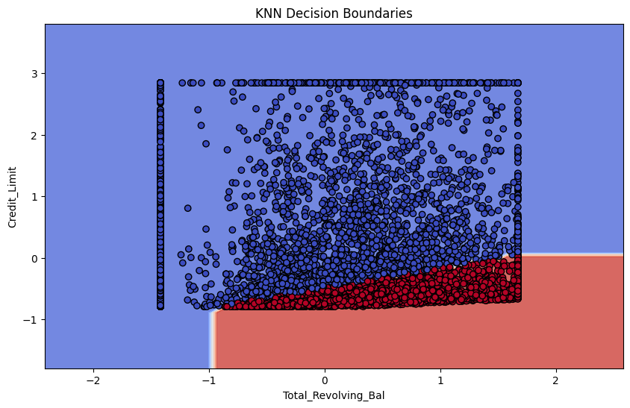
Model visualization For knn Modeling
KNN Decision Boundaries for Customer Risk Classification
Objective: Classify customers into risk groups using K-Nearest Neighbors (KNN).
Features:
X-axis: Total Revolving Balance (outstanding credit usage).
Y-axis: Credit Limit (available credit).
Decision Boundaries:
Blue Region: Low-risk customers (manageable credit usage).
Red Region: High-risk customers (overutilization of credit).
Key Insight: High revolving balances relative to credit limits are associated with higher risk.
Applications: Identify, monitor, and target high-risk customers for interventions.

Slide 15
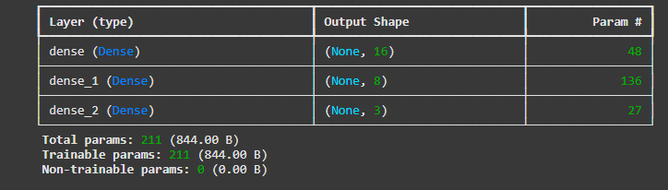
Neural Network Model Summary
Model Type: 3-layer Feedforward Neural Network
Total Trainable Parameters: 211
Layers:
First Layer (Dense): 16 neurons, 48 parameters
Second Layer (Dense): 8 neurons, 136 parameters
Third Layer (Dense): 3 neurons, 27 parameters
Fully Connected Layers: Each neuron connects to all neurons in the previous layer
Output Shape:
First Layer: (None, 16)
Second Layer: (None, 8)
Third Layer: (None, 3) (3 classes: Low Risk, Medium Risk, High Risk)
Notes:
All layers are trainable (weights and biases updated during training)

Slide 16
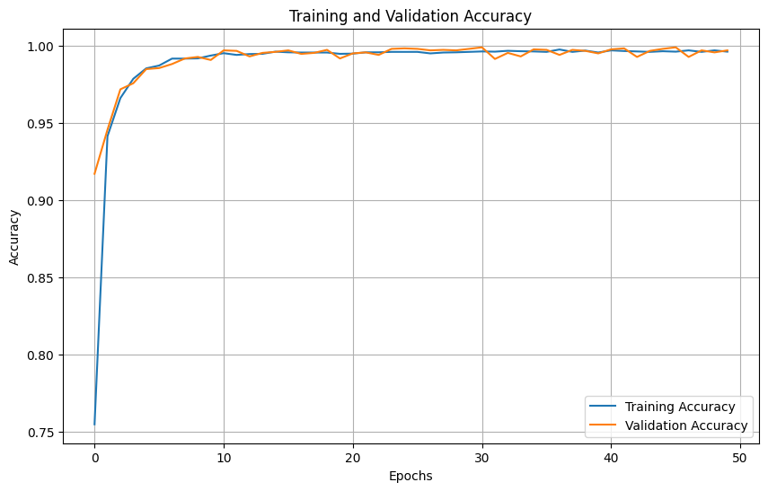
Neural Network Model Summary
Key Observations:
Both training and validation accuracy start at ~75% and rapidly increase to ~95% within the first 5 epochs.
The accuracy stabilizes close to 100% for both training and validation sets after epoch 5.
The training and validation curves are very close throughout, showing no signs of overfitting.
The model achieves near-perfect generalization on unseen data.
Conclusion:
The neural network is well-trained and generalizes effectively.
High accuracy suggests the dataset is relatively simple and has distinct clusters for classification.

Slide 17
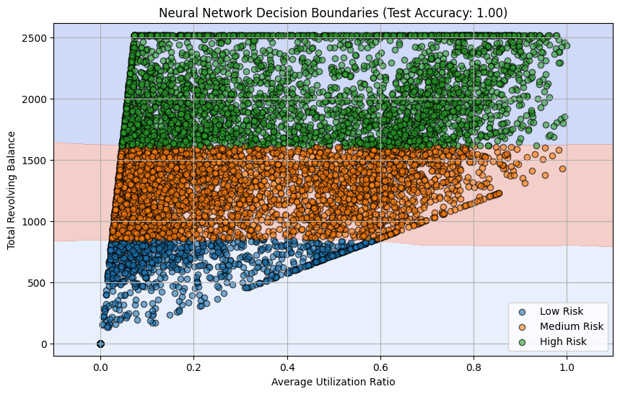
Neural Network Decision Boundaries
Objective:
Classify credit risk (Low, Medium, High) based on:
Average Utilization Ratio
Total Revolving Balance
Key Insights:
Accuracy: 100% test accuracy (perfect classification).
Decision Boundaries:
Low Risk (Blue): Low utilization and balance.
Medium Risk (Orange): Moderate utilization and/or balance.
High Risk (Green): High utilization and/or balance.
Clear separation of risk categories with nonlinear boundaries.

Slide 18

Recommendations
Cluster Applications:
Targeted Marketing: Utilize cluster characteristics to design personalized campaigns based on customer behaviors.
Improved Risk Assessment: Identify high-risk groups using cluster features to proactively mitigate credit issues.
Predictive Model Applications:
Forecast Utilization Ratios: Use predicted ratios to optimize credit resource allocation.
Identify High-Risk Customers: Leverage predictive insights to detect and manage at-risk customers effectively.
Nural network modeling:
Current Model Structure:
3 layers: 16 neurons (first), 8 neurons (second), and 3 neurons (output).
Total parameters: 211.
Activation functions: ReLU for hidden layers, Softmax for the output layer.
Current Performance:
Training and validation accuracy is nearly 100%.
There is no overfitting, indicating that the model generalizes well.
Notes:
Our recommendations leverage clustering and predictive modeling insights. Clusters enable targeted marketing and better risk assessment, while predictions of utilization ratios support efficient resource allocation and proactive management of high-risk customers."

Slide 19

Novelty and Creativity
Highlights:
Combined clustering and predictive modeling for comprehensive customer insights.
Introduced a Binary Inactivity Feature to capture inactive customer behavior.
Innovatively used categorical variables (e.g., demographic data) to extract actionable insights, correlating these with numerical features.
Techniques such as One-Hot Encoding and Ordinal Encoding ensured proper representation of categorical data.
Employed GridSearchCV Optimization for the predictive model to improve accuracy.
Advanced visualizations using 2D and 3D PCA for cluster analysis, SHAP plots for feature explainability, and feature importance ranking to identify key predictors like Education Level and Gender.
Excellent Performance: Nearly 100% accuracy on training and validation with no overfitting.
Lightweight Model: A 3-layer network with 211 parameters, efficient and easy to deploy.
Clear Data Patterns: Features like Avg_Utilization_Ratio and Total_Revolving_Bal drive strong predictability.
Notes:
The novelty in our approach lies in combining clustering with predictive modeling, introducing innovative features like binary inactivity, and employing advanced techniques such as GridSearchCV and SHAP visualizations. This provides a comprehensive and creative view of customer behavior."

Slide 20

Conclusion
Key Findings:
Clear Customer Segmentation:
Successfully grouped customers into three clusters (Moderate, Budget-Conscious, and High-Value).
Identified key features driving clustering decisions, such as Education Level and Credit Limit.
Accurate Predictive Modeling:
Developed models like Random Forest Classifier and KNN Regression.
Achieved perfect classification accuracy (1.00) for clustering predictions and robust results for utilization ratio prediction (MAE = 0.18, R² = 0.76).
2. Future Work:
Feature Exploration:
Incorporate additional data such as loyalty program trends and transaction timestamps for deeper insights.
Explore alternative clustering techniques like DBSCAN to improve segmentation accuracy.
Model Enhancement:
Experiment with advanced predictive algorithms, such as Gradient Boosting and Neural Networks, for improved precision.
Introduce real-time prediction pipelines for actionable insights.
Notes:
To conclude, we achieved two key outcomes: clear customer segmentation using clustering and accurate prediction of utilization patterns with the KNN regression model. Moving forward, we suggest exploring additional features like transaction trends and loyalty data, and testing alternative algorithms like DBSCAN and Gradient Boosting to enhance insights and accuracy

Slide 21

Queries, Concerns

